Slide 1


2
Greater Noida Institute of Technology
Engineering Institute (Greater Noida )
Title :- INTERACTIVE DASHBOARDS AND VISUAL ANALYTICS: ENHANCING DECISION MAKING IN BUSINESS INTELLIGENCE
Supervisior Submitted By :-
Mr.Harendra Singh Aniket Kushwaha (2401320140028)
CO.Supervisior
Dr. Abdul Alim

Slide 2
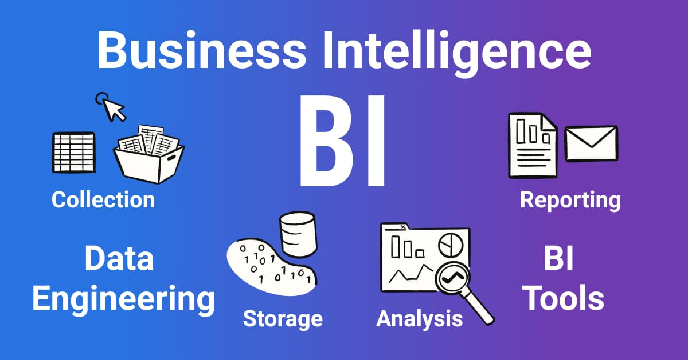
Introduction
3
BI Integrates data collection, analysis, and visualization.
An interactive dashboard is a visual interface that displays key performance indicators (KPIs), charts, and metric in a single screen.
Visual Analytics is done in Descriptive Analysis, which is one of the four types of Data Analytics Categories

Slide 3
Problem Statement
4
There is a clear need for an interactive, user-friendly, and real-time visual analytics dashboard that transforms raw data into intuitive, actionable insights.
This project aims to solve the problem by designing and implementing a BI-driven dashboard that enhances decision-making, improves operational efficiency, and empowers businesses to make strategic, informed, and faster decisions.
Growing use of dashboards in BI
Descriptive analytics through visuals
Interactive features enabling exploration

Slide 4
Context & Data Sources
5
The dataset used for this project is amazon.csv, collected from Kaggle. It contains product-level information from an e-commerce platform. The dataset includes:
📌 Key Attributes
Product Details: product name, category, description
Pricing Information: actual price,discounted price
Ratings Data: rating value, rating count
Seller & Listing Information: seller name, product link
Other Attributes: image link, sub-category, stock availability
📌 Why This Dataset?
The dataset represents realistic e-commerce operations, allowing creation of dashboards such as:
Sales analytics
Pricing insights
Product comparison

Slide 5
Project Goal
6
To build an interactive BI dashboard that transforms complex business data into visually clear insights, enabling faster, smarter, and more informed decision-making.
To create an interactive BI dashboard for better insights.
To convert raw data into clear visual information.
To support faster and smarter decision-making.
To identify trends, patterns, and key business metrics.

Slide 6
Tools and Technologies
7
Power BI: Microsoft’s Interactive Analytics Tool.
Jupyter Notebook: Datagraphs,heatmaps,scatterplots.
Google Data Studio: Data Collection.
Python Libraries:
• Pandas • Numpy• Matplotlib • Plotly • Seaborn
Models: Linear Regression
Algorithm: Train & Test

Slide 7
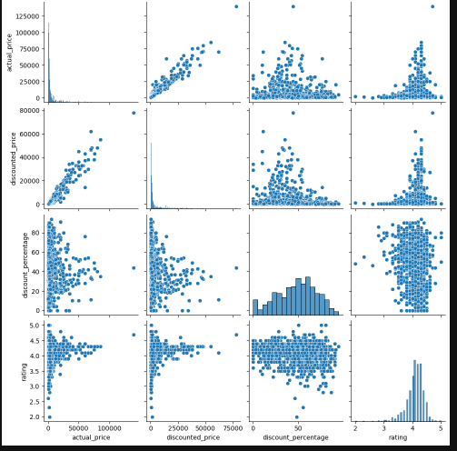
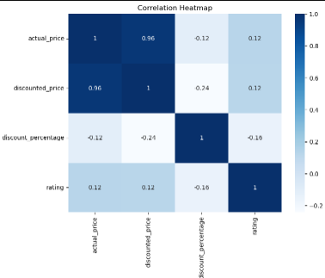
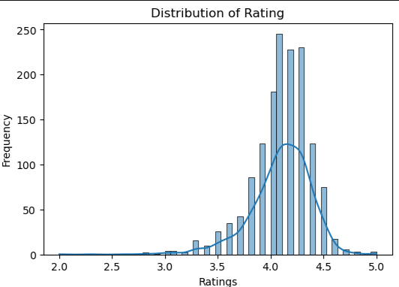
Visual Analytics
8

Slide 8
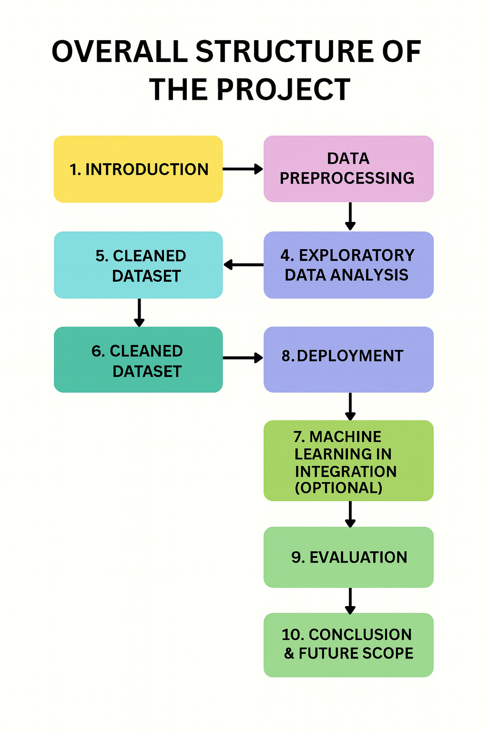
9

Slide 9
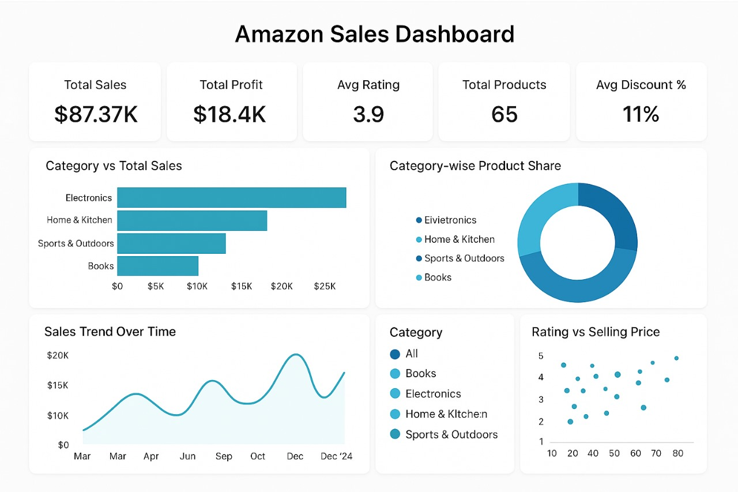
Interactive Dashboard Design
11
• Overview, Product, Seller, Profitability dashboards
• Interactivity: filters, drill‑down, slicers, tooltips
• Visuals: bar, line, heatmaps, KPIs, scatter

Slide 10
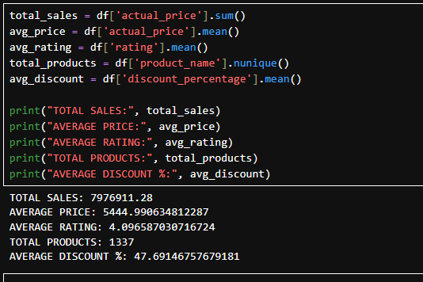
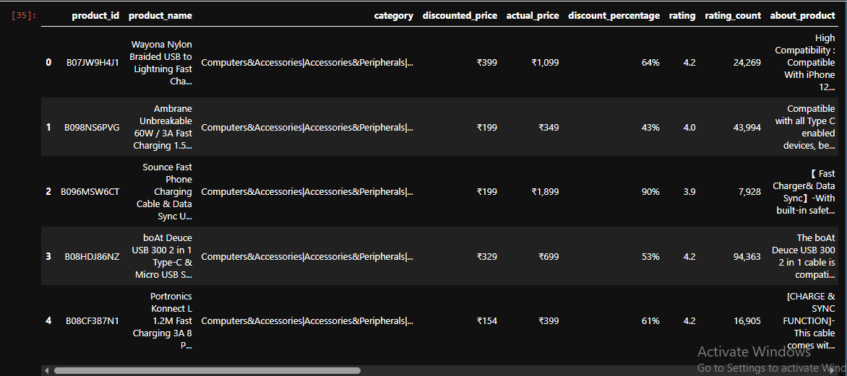
System Output (Prediction)
The system calculates key business metrics from the dataset, including:
Total Sales: ₹7,976,911.28
Average Price: ₹5,444.99
Average Rating: 4.09
Total Products Analyzed: 1337
Average Discount Percentage: 47.69%
These outputs summarize the overall performance of products on the platform.
10

Slide 11
Conclusion & Future Work
13
✅ Conclusion
The interactive dashboard successfully transforms raw data into meaningful insights.
Key metrics like sales, pricing trends, ratings, and discounts were analyzed effectively.
The system supports better decision-making through visual analytics.
🚀 Future Work (Short & Clear)
Integrate real-time data updates for live tracking.
Add advanced ML models for prediction and forecasting.
Include customer segmentation and behavior analysis.
Deploy dashboard on cloud with automated refresh scheduling.

Slide 12
Thank You
12

